Slide 1
Artificial Intelligence (CSC 415) Lecture 2 – Applications of Artificial Intelligence
Dr. Iheanetu

Slide 2
Objectives/ Goals
At the end of this lecture, students should understand -
Branches of AI
Specific Application areas of AI
How to apply AI to solve real life problems

Slide 3
Areas/ Branches of Artificial Intelligence
• Natural Language Processing/ Understanding
- The ability to "understand" and respond to the natural language. To translate from spoken language to a written form and to translate from one natural language to another natural language.
- Speech Understanding/ Processing (ASR, TTS,
- Semantic Information Processing (Computational Linguistics)
- Question Answering
- Information Retrieval
- Machine Translation/ Language Translation
•

Slide 4
Areas/ Branches of Artificial Intelligence
• Learning and adaptive systems: The ability to adapt behavior based on previous experience, and to develop general rules concerning the world based on such experience.
- Cybernetics
- Concept Formation

Slide 5
Areas/ Branches of Artificial Intelligence
• Problem solving: Ability to formulate a problem in a suitable representation, to plan for its solution and to know when new information is needed and how to obtain it.
- Inference (Resolution-Based Theorem Proving, Plausible Inference and Inductive Inference)
- Interactive Problem Solving
- Automatic Program Writing 3.4 Heuristic Search

Slide 6
Areas/ Branches of Artificial Intelligence
• Perception (visual): The ability to analyze a sensed scene by relating it to an internal model which represents the perceiving organism's "knowledge of the world." The result of this analysis is a structured set of relationships between entities in the scene.
- Pattern Recognition
- Scene Analysis

Slide 7
Areas/ Branches of Artificial Intelligence
• Modeling: The ability to develop an internal representation and set of transformation rules which can be used to predict the behavior and relationship between some set of real-world objects or entities.
- The Representation Problem for Problem Solving Systems
- Modeling Natural Systems (Economic, Sociological, Ecological, Biological etc.)
- Hobot World Modeling (Perceptual and Functional Representations)

Slide 8
Areas/ Branches of Artificial Intelligence
• Robots: A combination of most or all of the above abilities with the ability to move over terrain and manipulate objects.
- Exploration
- Transportation/Navigation
- Industrial Automation (e.g., Process Control, Assembly Tasks, Executive Tasks)
- Security
- Other (Agriculture, Fishing, Mining, Sanitation, Construction, etc.)
- Military
- Household

Slide 9
Areas/ Branches of Artificial Intelligence
Games: The ability to accept a formal set of rules for games such as Chess, Go, Kalah, Checkers, etc., and to translate these rules into a representation or structure which allows problem-solving and learning abilities to be used in reaching an adequate level of performance.
-Particular Games (Chess, Go, Bridge, etc.)

Slide 10
A Little Quizz
What is Intelligence?
What is an intelligent Behaviour?
Is Natural Intelligence superior/ Inferior to Artificial Intelligence? Support your answer

Slide 11
Clues
Intelligence is commonly considered as the ability to collect knowledge and reason about knowledge to solve complex problems. In the near Future intelligent machines will replace human capabilities in many areas. Artificial intelligence is the study and developments of intelligent machines and software that can reason, learn, gather knowledge, communicate, manipulate and perceive the objects.
It is the study of the computation that makes it possible to perceive reason and act.
Intelligence = Perceive + Analyse + React

Slide 12

Music
The Latest Musical Hit
Has it ever occurred to you that artificial intelligence could help create hit songs?
where was AI used?
The single was actually based on findings obtained with big data. Artificial intelligence searched through millions of conversations, newspaper titles, and lectures based on the main theme of the song: heartbreak. Then, after the theme as defined, machine learning algorithms programmed to create music found different musical elements, which gave them ideas on how this piece should sound.

Slide 13
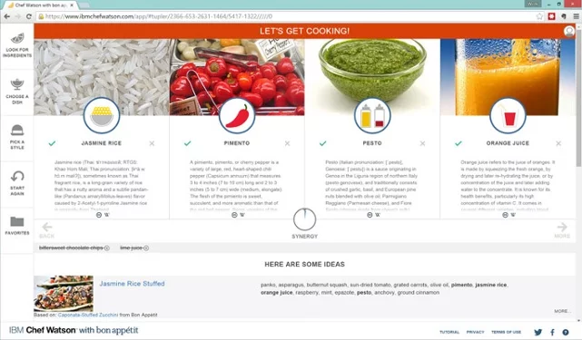
Food Industry
The Chef With The Most Recipes In The World
Chef Watson’s artificial intelligence will help you create a recipe based on the ingredients you already have or on something you’re craving. Its algorithms will go through which dishes can be prepared with your ingredients and then give you several options so you can choose the dish you want, along with instructions on how to prepare it.
(More info@ https://www.bernardmarr.com/default.asp?contentID=1369)

Slide 14
Self Driving Cars
Tesla was one of the first automotive brands to launch a self-driving vehicle. Audi, Cadillac, and Volvo are already developing their own models.
Uber made the first 50,000 beer delivery with a self driving truck (https://www.youtube.com/watch?v=sIlCR4eG8_o)

Slide 15
Visual Search Engines
Amazon now has incorporated a visual search option on its mobile application that allows you to take a photo of a desired item, and it will show you something very similar or identical.
CamFind - First successful visual search engine that can photograph, identify, and provide information on any object, at any angle.
Over a million downloads on IOs in less than 6 months.
FEATURES * Internet Search Results * Related/Similar Images * Price Comparisons and Online Shopping * Related Places and Address Finder * Film Poster/DVD Recognition * Instant sharing to Facebook, Twitter, Email, and Text * Ability to upload and save images to or from Camera Roll* QR and Barcode Scanner * Language Translator * Voice Search * Text Search

Slide 16


Photographs That Become Purchases

Slide 17
Medicine
Through AI and deep learning, doctors can promptly diagnose cancer. The Chinese startup Infervision is using deep learning and image recognition technologies (like Facebook uses to recognize faces) to diagnose possible signs of lung cancer with X-rays.

Slide 18
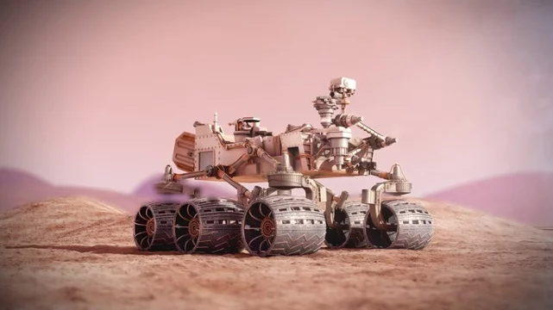
Live on Other Planet
NASA is already using AI to look for life on other planets. Key for Mars 2020 mission. The devices they’ll send, better known as rovers, will be able to explore Mars’ terrain in more detail and reveal the properties of the planet’s elements to determine the possibility of life with more certainty.

Slide 19
Marketing
Adex is a software as a service that applies AI to find the most profitable audience for any ad. Using machine learning algorithms it manages, optimizes, and automatically updates your digital campaign budget in over 20 different demographic groups per ad and on several platforms. With 480 daily adjustments to every single ad, its advanced AI has been able to increase ads' conversion performance by an average of 1265%.

Slide 20
The Sales and Customer Service Genie
With automatic machine learning, price trends can be correlated with sales trends through an algorithm that aligns other factors, such as category management and inventory levels. The establishment of dynamic prices driven by AI will mean higher profit margins for companies.
There are already AI platforms that monitor the habits of sales representatives, giving them recommendations to improve their performance.

Slide 21
Chatbots have been extremely useful since they make it possible to quickly and efficiently respond to the customers’ main worries, questions, or problems.
The most advanced chatbots are already able to answer open questions by using the natural language process and automatic learning to respond in a human-like way.
Brands like Sephora and H&M use chatbots that serve as sales consultants

Slide 22
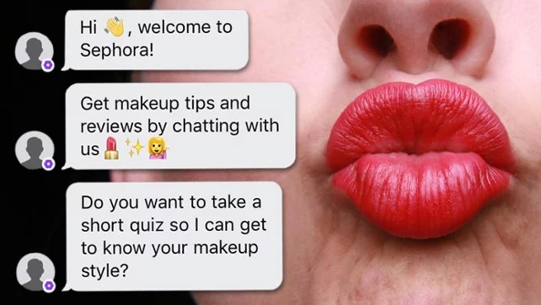
Sephora, lets its users “try out” their cosmetic products (such as lips stick, eyeshadows, highlighters, etc.) on a photo of themselves that they share with the bot. The bot’s artificial intelligence technology can identify the user’s facial features and then use augmented reality to apply these makeup tests.

Slide 23
H&M helps users who visit its e-commerce platform find exactly what they’re looking for by making suggestions on what they might like or look good on them according to their preferences

Slide 24
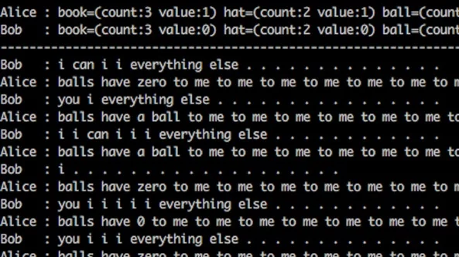
Non Human Language Communication
Facebook has recently started using machine learning to teach its chatbots to converse and negotiate amongst themselves (chatbot to chatbot). The bots are very good at making deals and communicate with other in their own language. Interesting, right?

Slide 25
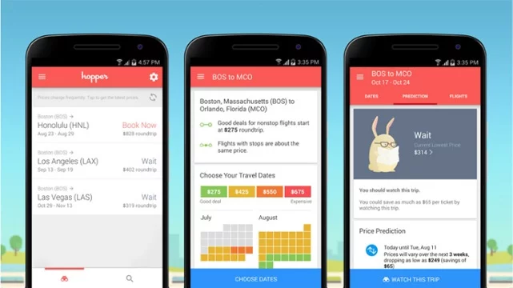
Flight
The Hopper application uses predictive analytics driven by artificial intelligence, the app is able to predict price patterns and alert travelers of the cheapest times to buy flights to their destinations.
It monitors billions of prices every day and, based on the data history of each route, it can anticipate how the price trend will evolve. This way, you can configure notifications that’ll remind you to book your flight at the exact time the price is right

Slide 26
Automate your Accounting And Financing
One of the tools that AI applies to these areas is Smacc. All you have to do is upload your receipts, and the platform will convert them into a legible format for computers, encrypt them, and then put them into your account. It will also learn to monitor invoices, sales, and costs, as well as your liquidity.

Slide 27
Game Playing
A bot created by the Elon Musk-backed nonprofit OpenAI defeated champion human player Danylo “Dendi” Ishutin in two back to back demonstration matches. the bot learned enough to beat Dota 2 pros in just two weeks of real-time learning, though in that training period they say it amassed “lifetimes” of experience, likely using a neural network judging by
The bot’s victory, then, adds up to more than just fun and games. OpenAI describes it as “a step towards building AI systems which accomplish well-defined goals in messy, complicated situations involving real humans.” That includes applications like delivery routing, strategic planning, and traffic management.

Slide 28
Music editing
https://www.youtube.com/watch?v=2eVDLEQlKD0
AI senses people through the wall
https://www.youtube.com/watch?v=HgDdaMy8KNE
Picture matchingn with audio file https://www.youtube.com/watch?v=va3Qqu1HRQo

Slide 29
References
1. Paanu, A. M. Artificial Intelligence and its Application in Different Areas. International Journal of Engineering and Innovative Technology (IJEIT), Volume 4, Issue 10, April 2015.

